Slide 1

SMART STORAGE CHECKING SYSTEM
Tolga Değirmenci
19COMP1029
İlkim Sevinç
19COMP1034

Slide 2
WHY WE CHOOSE THIS TOPIC?
IoT-based store management system can provide real-time monitoring, automated reordering, inventory tracking, data analysis and cost savings.
This can help manage the whole store or a section more efficiently, resulting in better storage and cost management.

Slide 3
PROBLEM?
Suppose you are a store manager in charge of chocolate section. You need to see when there is not enough chocolate to display. So, you need to get chocolate from storage and get it to the section. But if you don’t know the amount displayed, you need to go to the section and get informed.
Suppose you are a storage manager. You need to see when there is not enough chocolate in storage. To be informed, you need to go to the storage and inform yourself and order manually.

Slide 4
PROBLEM SOLUTION
We developed a system to measure the weight of the chocolate storage and calculate how many pieces exist. The measurements will be visualized via Thingspeak and user can reach that values from anywhere that is connected to the internet. If there are chocolate pieces fewer than a predetermined value, the system will inform the user via email.
After that, the user can be informed or the storage and decide whether to order new chocolate package.
This project can be improved as a “Self-Ordering Storage Management System” in the future.

Slide 5
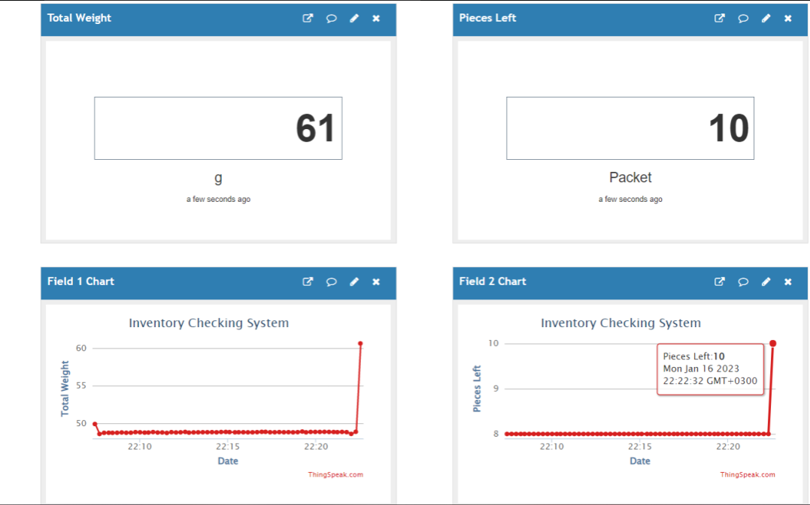
TEST RESULTS

